Slide 1
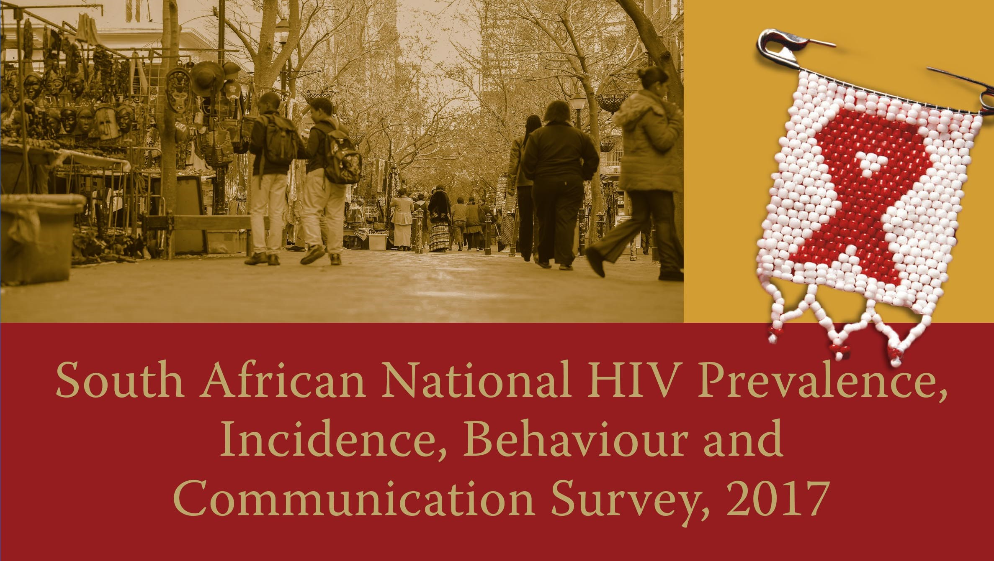

Slide 2








Collaborators

Slide 3
Outline of the presentation
Background
Research methods
Findings
    Response rates
    HIV incidence
    ART exposure
    Viral load suppression
    90-90-90
    HIV prevalence
    Behavioural measures
Conclusions and recommendations

Slide 4
Introduction (1/2)
South Africa has the biggest HIV epidemic in the world, with an estimated 7.1 million people living with HIV (UNAIDS Data, 2017)
The country has the largest ART programme in the world, which has undergone even more expansion in 2016 with the implementation of ‘universal test and treat’ policy
The national HIV response is coordinated by the South African National AIDS Council
HIV surveillance has been key in monitoring the response to the epidemic

Slide 5
Introduction (2/2)
To date, the HSRC and its partners have undertaken five population-based surveys in this regard
Previous surveys were conducted in 2002, 2005, 2008 and 2012
These surveys have provided an important gauge of the HIV epidemic of South Africa
This presentation is on the fifth survey in the series conducted in 2017

Slide 6
Research Methods
Survey design
A cross-sectional, population-based household survey was conducted using a multi-stage stratified cluster random sampling approach
The study design was based on the methods used and validated in the four previous surveys carried out by HSRC in 2002, 2005, 2008 and 2012 including linked anonymous testing with informed consent
Survey population
This survey included persons of all ages living in South Africa.
All members of the selected households were invited to participate, including those living in hostels

Slide 7
Research Methods
Sampling frame – SABSSM V
National + 16 District/metro-level estimates
1000 SALs
National sampling frame
Selected districts
sampling frame
Additional SALs
585 SALs
457 SALs
Natl. sampling frame
SALs contributing to
16 district/metro-
level estimates

Slide 8
Survey data collection tools
Questionnaires
Four questionnaires were used in this survey:
Household Questionnaire
Questionnaire for parent/guardian of children aged 0 to 11 years
Questionnaire for children aged 12 to 14 years
Questionnaire for persons aged 15 years and older
The main focus of the study was on knowledge, attitudes and behaviour.
New modules were added: tuberculosis (TB), Inter-partner violence and exposure to various HIV communication campaigns

Slide 9

Response Rates, South Africa 2017
Valid households | 11,743
Eligible individuals | 39 132
Blood samples | 23,923
Household level response (%) | 82.2
Individual level response (%) | 93.6
HIV testing response (%) | 61.1

Slide 10
HIV testing procedure
All DBS samples were tested for HIV in the laboratory using approved methods
Those found to be positive were confirmed by doing two additional tests
One tenth of all specimens that were found to be negative were also tested once more using another test for quality assurance purposes

Slide 11
Laboratory Testing: National HIV Household Survey South Africa 2017
Dried Blood Spot
HIV Ab screening
Nucleic Acid
Amplification Test
HIV Pos
HIV Incidence
(> 2 years)
HIV
Drug Resistance *
ARVs
Viral Load
*Results still being finalised

Slide 12
Ethics
Ethics approval was received from both HSRC and CDC
Participants had to provide informed consent in order for them to take part in the study

Slide 13
Understanding the HIV epidemic
New infections
On ART
Prevalence
Not on
ART
Deaths

Slide 14
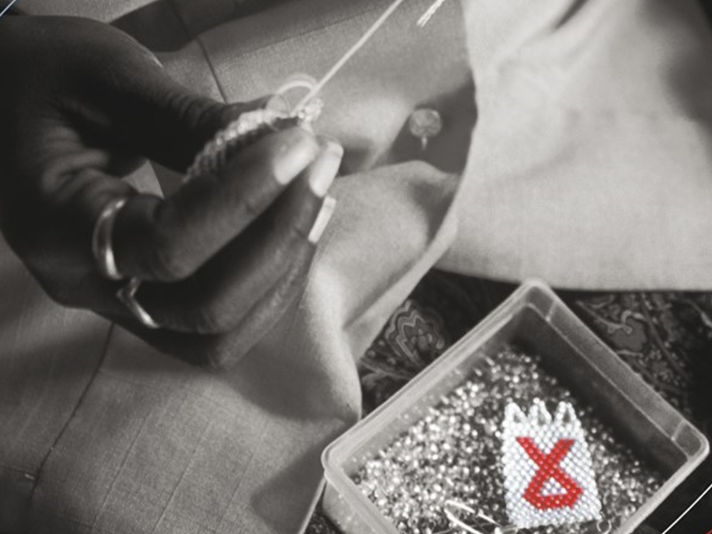
HIV Incidence

Slide 15
Recent Infection Detection Algorithm
HIV + (≥ 2 yrs)
OUTCOME
LAg-Avidity EIA
LT-Long-term
Chronically infected subjects
Recent
ARV Testing
ARV Positive
Chronically infected subjects
receiving HAART *
Negative
Viral Load
<1000 copies/mL
Chronically infected elite suppressor
or subjects with low VL
>1000 copies/mL
Recently infected individuals

Slide 16
Overall HIV Incidence among those aged two years and older by Sex, South Africa, 2017
The overall incidence rate was 0.48 % which translates to 231 000 new infections
Incidence was higher among females (0.51% =>122 000 new infections) as compared to males (0.46% => 109 000 new infections)

Slide 17
HIV Incidence among youth aged 15 to 24 years by Sex, South Africa, 2017
Overall incidence was 1.0 % which translated to 88 000 new infections
The incidence was three times higher among females (1.51% translating to 66 000 new infections) compared to males (0.49% translating to 22 000)
Over a third (38.0%) of all new infections come from this age group

Slide 18
HIV Incidence among those in the aged group 15 to 49 years by Sex, South Africa, 2017
Overall incidence in the reproductive age group was 0.79 % which translates to 200 000 new infections
The incidence was higher among females (0.93% translating to 107 000 new infections) compared to males (0.69% translating to 92 000 new infections)

Slide 19
Changes to HIV Incidence among those aged two years and older by Sex, South Africa, 2012-2017
NB. The 2012 results were re-calculated using the 2017 test parameters
The overall HIV incidence has significantly dropped by 44%.
The largest decline (56%) in incidence was among females.
Among males the incidence declined by 18%

Slide 20
Changes to HIV Incidence among those aged 15 to 24 years by Sex, South Africa, 2012-2017
The overall HIV incidence among youth declined by 17%
The decline in incidence was only among females (26%)
Whilst among males incidence increased by 11%

Slide 21
Changes to HIV Incidence among those aged 15 to 49 years by Sex, South Africa, 2012-2017
The overall HIV incidence in the reproductive age group has dropped significantly by 42%
The biggest decline (49%) in incidence was among females
Among males the incidence declined by 28%

Slide 22
ARV treatment & exposure

Slide 23
ART exposure, South Africa, 2017
Variable | Estimated number of people on ART (n) | Proportion of people living with HIV on ART (%) 95% CI
National | 4,401,872 | 62.3 (59.2-65.2)
Female | 2,998,170 | 65.5 (62.4-68.4)
Male | 1,403,702 | 56.3 (51.0-61.5)

Slide 24
ART exposure by age group,
South Africa, 2017
Age group (years) | Estimated number of people on ART (n) | Proportion of people living with HIV on ART (%) 95% CI
Total | 4,401,872 | 62.3 (59.2-65.2)
0-14 | 131,052 | 50.0 (36.6-63.3)
15-24 | 273,981 | 39.9 (32.1-48.3)
25-49 | 3,243,819 | 63.1 (59.2-66.8)
50 and older | 753,020 | 76.7 (71.3,81.4)
15-49 | 3,517,800 | 60.4 (57.0-63.6)

Slide 25
Viral Load Suppression

Slide 26
Overall viral suppression by age, South Africa, 2017
HIV viral load suppression, defined as a viral load threshold of <1000 copies HIV RNA/ml, is a measure of ARV therapy efficacy

Slide 27
Viral load suppression among PLHIV on ART
The current policy is to test and treat everyone who is HIV positive as soon they are diagnosed
Overall viral suppression was 87.3% in PLHIV on treatment, in all age groups
The lowest viral suppression levels in ART users were among males (82.4%), 0–14 year olds (81.9%), PLHIV on farms (82.6%) and those living in Mpumalanga (82.9%)
However not everyone who is living with HIV is on treatment, and consequently it was found that only 62.3% of all PLHIV irrespective of treatment were virally suppressed

Slide 28
Viral suppression among all PLHIV irrespective of treatment by age and sex, South Africa, 2017

Slide 29
90-90-90

Slide 30
90-90-90 - 15 to 64 years of age

Slide 31
HIV Prevalence

Slide 32
Overall HIV prevalence
The estimate of HIV prevalence among South Africans of all ages in 2017 was 14.0% (95% CI: 13.1-15.0)
This translates to 7.9 million (95%CI:7.1 million - 8.8 million) PLHIV
This increase is approximately 1.6 million more PLHIV when compared to 2012
2012 estimate of HIV prevalence among South Africans of all ages was 12.2% (95% CI: 11.4-13.1)

Slide 33
HIV prevalence by sex, South Africa, 2017

Slide 34
HIV by province, South Africa, 2017

Slide 35
HIV by Age and Sex, South Africa (2012 vs 2017)

Slide 36
Circumcision

Slide 37
Trends in adult male self-reported circumcision, South Africa, 2002-2017

Slide 38
Behavioural Measures:
Condom Use & Sexual Partnerships

Slide 39
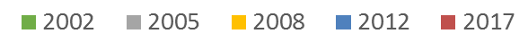
Condom use at last sex, South Africa, 2002-2017

Slide 40
Sexual debut among respondents aged 15–24 years, South Africa, 2002 - 2017

Slide 41
Multiple partners in the last 12 months, South Africa, 2002-2017

Slide 42
Age-disparate sexual relationships in 15-19 years age group by sex, South Africa, 2002-2017
*Numbers reported for males with a partner 5 or more years older than them are few and should be interpreted with caution

Slide 43
Behavioural Measures:
Perceptions, Knowledge & SBCC

Slide 44
HIV status by perceived risk of HIV, South Africa, 2017
Sex | Low-risk perception |  |  | High-risk perception
 | n | HIV + (%) | 95% CI | n | HIV + (%) | 95% CI
Female | 7953 | 11.2 | 10.0-12.5 | 1336 | 23.3 | 20.5-26.3
Male | 5720 | 8.8 | 7.7-10.0 | 974 | 11.2 | 8.8-14.2
Total | 13673 | 10.0 | 9.1-11.0 | 2310 | 17.2 | 15.3-19.3

Slide 45
Awareness of HIV status, South Africa, 2017
In total 75.2 % had been ever tested for HIV, with more females (79.3%) having done so than males (70.9%)
Receiving HIV status in the last 12 months increased from 49.1% in 2008 to 66.8% in 2017
HIV positive male youth were less aware of their status in the last 12 months as compared to females

Slide 46
Perceptions about PLHIV, South Africa, 2008-2017
If you knew that a shopkeeper or food seller had HIV, would you buy food from them?
Would you be willing to care for a family member with AIDS?
If a teacher has HIV but is not sick, he or she should be allowed to continue to teach?
It is not a waste of money to train or give a promotion to someone with HIV/AIDS?
Would you want to keep the HIV positive status of a family member a secret?
Are you comfortable talking to at least one member of your family about HIV/AIDS?

Slide 47
Social and Behaviour Change Communication (SBCC)
Programmes covered
    Soul City
    Centre for Communication Impact (CCI)
    LoveLife
    Community Media Trust
Target groups
    Young women and girls/young people e.g. Rise clubs, ZAZI, LoveLife
    Men e.g. Brothers for Life

Slide 48
Sexual behaviour by SBCC exposure level, South Africa, 2017

Slide 49
Conclusions and Recommendations

Slide 50
Conclusions, South Africa, 2017 (1/4)
Successes
HIV incidence has significantly declined since 2012 by 44% (378,700 new infections in 2012 to 231,100 new infections in 2017)
  The biggest decline was 56% among females
Compared to the previous year estimates
  Overall, from 2016 (270 000) to 2017 (231 000) the number of new HIV infections dropped by 14%
  New infections among AGYW were 1 300 per week, which is 35% less than the estimated 2 000 weekly new infections in 2016 (NSP, 2017)
ART uptake more than doubled from the 2012 survey
  This increased access to ART contributes to an increase in life expectancy as seen in the aging profile among PLHIV
Increases in medical male circumcision since 2012
  Over two-thirds of males aged 15-24 years are circumcised, over half of these are medical circumcisions

Slide 51
Conclusions, South Africa, 2017 (2/4)
Successes continued
Improvement in HIV testing, increasing awareness of HIV status
The majority of respondents held positive attitudes toward PLHIV, which are consistent with low levels of stigma over time
HIV communication campaigns are reaching South Africans
Significant progress has been made towards the UNAIDS 90-90-90 targets. By 2017, South Africa had attained 85-71-86
Compared to 2012 multiple sexual partnerships have decreased among young males, but still remain relatively high

Slide 52
Conclusions, South Africa, 2017 (3/4)
Challenges
The number of new HIV infections are still high, especially among females aged 15-24 years(1.51%) and females aged 15-49 years (0.93%)
  As a result of the above, HIV prevalence and number of PLHIV have increased
  This increase was also seen in all provinces, with substantial increases in both EC and WC
Not all PLHIV are aware of their status, especially males
Not everyone who is HIV positive is currently on treatment and as a result overall viral suppression among all PLHIV population is 62.3%
  Lower among males and younger age groups

Slide 53
Conclusions, South Africa, 2017 (4/4)
Challenges continued
Consistent condom use continues to be low
Sexual debut before the age of 15 years among male youth continues to increase
The number of adolescents girls who had sexual relationships with older sexual partners continue to increase

Slide 54
Recommendations, South Africa, 2017 (1/2)
The following recommendations are made to SANAC, all government departments, civil society, labour, business, donors, traditional leaders and, more importantly, individuals:
There is a need to strengthen targeted and comprehensive evidence-based multi-sectoral response to the HIV and AIDS epidemic
  Strengthen, expand and support the ART programme with focus on reaching males and the younger population
  Make available proven combination prevention interventions, continuing emphasis on high-risk groups especially females aged 15-24 years
    Condoms
    PrEP
  Revitalize and strengthen behaviour change interventions including on:
    Risk perception highlighting the fact that everyone is at risk of HIV infection
    Improving treatment literacy among population to drive demand and adherence

Slide 55
Recommendations, South Africa,
2017 (2/2)
  Promote circumcision and create demand for VMMC with an immediate goal to saturate the 15-34 year old age group
  Promote the elimination of mother-to-child transmission (EMTCT) of HIV
  Existing and new evidence needs to be used to inform new and more innovative SBCC campaigns, especially addressing social cultural issues and risk behaviours
  Support a targeted implementation of a widespread HIV testing and timely linkage to care campaign or programme
    for those with a known HIV+ status who were tested before the introduction of test and treat in 2016 should be encouraged to ‘return to care’

Slide 56







Funders
U.S. President’s Emergency Plan for AIDS Relief (PEPFAR)
through the U.S. CDC (Cooperative Agreement #GH001629)
Department of Science and Technology, South African National AIDS Council, Global Fund, Right to Care, UNICEF, Centre for Communication Impact, Soul City, LoveLife
The findings and conclusions in this presentation are those of the author(s) and do not necessarily represent the official position of the CDC.
The mark “CDC” is owned by the US Dept. of Health and Human Services and is used with permission. Use of this logo is not an endorsement by HHS or CDC of any particular product, service, or enterprise.

Slide 57

Thank you for your attention

